Slide 1

W
L
O
E
E
C
M

Slide 2

Quota movement timeline: Unfolding events
Md. Inzamamul Haque
Department of Political Science, University of Barishal, Barishal-8254, Bangladesh
EDGE- Digital Skills for Students
Roll No: 01-051-13

Slide 3
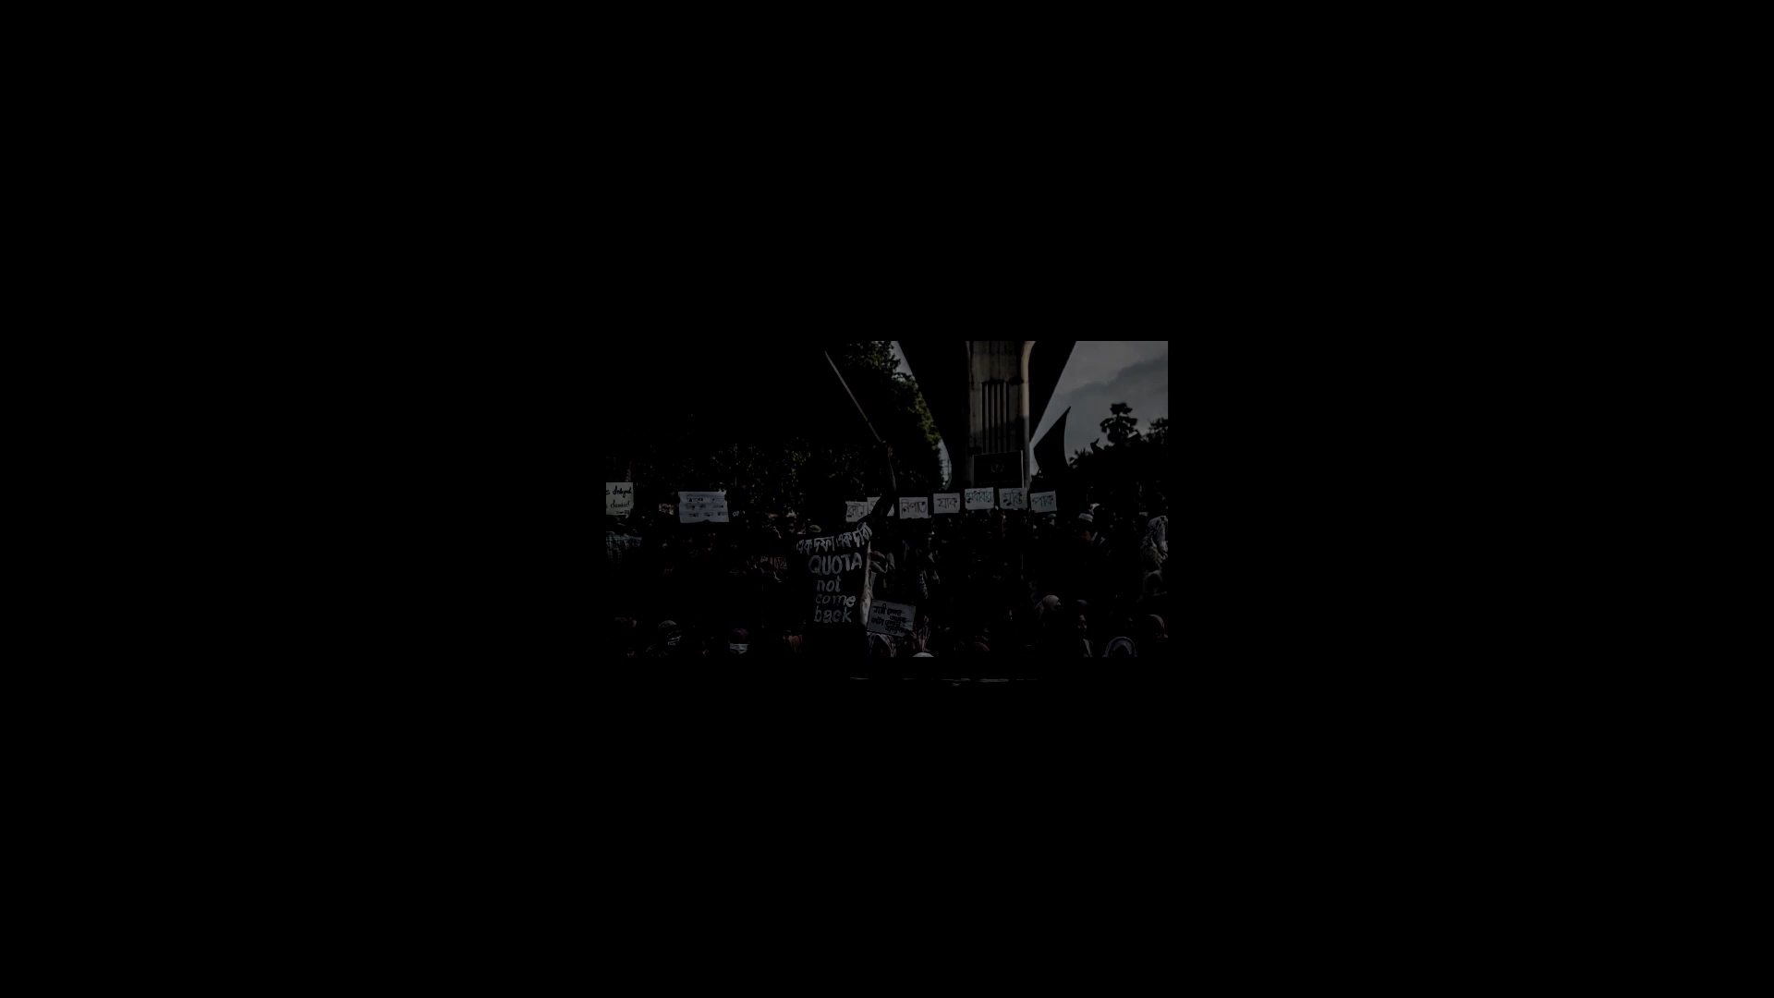

Slide 4
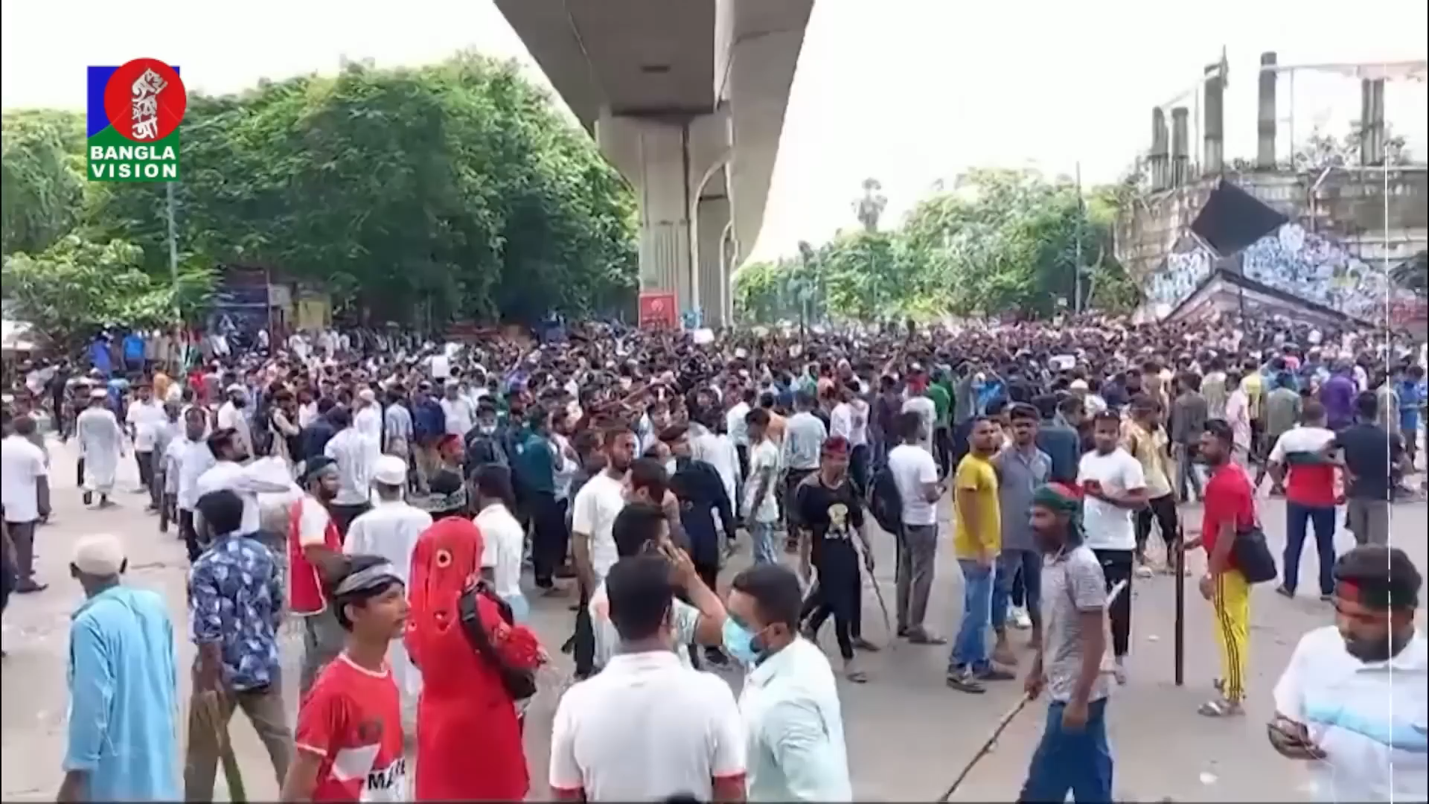

Slide 5
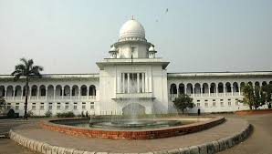
Background: The quota system was introduced to ensure representation for underprivileged groups in government jobs and education.
Demand for Reform: Students and job seekers protested, claiming the quota system was unfair and hindered merit-based selection.
Major Protest in 2018: A nationwide movement erupted in 2018, led by university students, demanding the reform of the quota system.

Slide 6
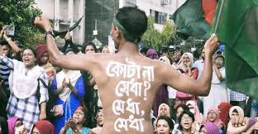
The protest began in June 2024

Slide 7
Quota in govt jobs in 2024

Slide 8
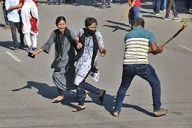
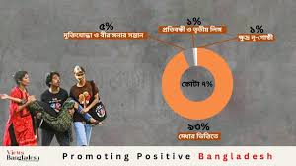
19 July, Friday Capital Dhaka was rocked by unprecedented violence, firing, arson and deaths centering the ‘complete shutdown’ of the students protesting demanding quota reform in government jobs. Clashes took place in other districts too. At least 44 killed in the city alone in firing and clashes. A total of 56 were killed outside Dhaka

Slide 9
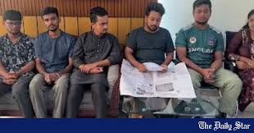
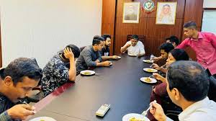
28 July, Sunday Detective Branch (DB) of the Dhaka Metropolitan Police (DMP) takes one of the coordinators of the quota reform movement, Nusrat Tabassum, into custody

Slide 10
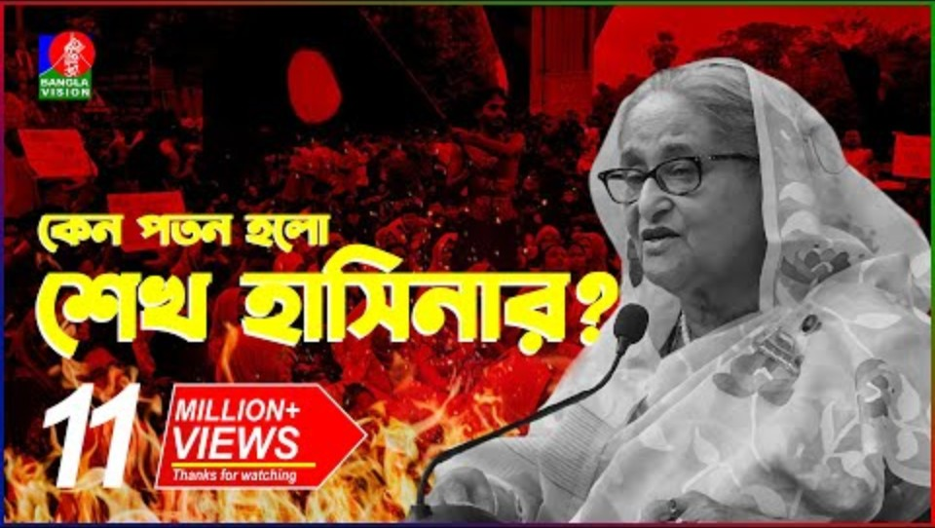
Summary of Quota Movement in Bangladesh (1 July - 5 August)
During this period, the Quota Reform Movement in Bangladesh gained momentum as students and job seekers continued to demand reforms to the existing quota system in government jobs. The protests focused on reducing the high percentage of reserved quotas, particularly the 56% allocated for various groups, which the protesters argued hindered merit-based recruitment. Tensions escalated as demonstrations spread across the country, with significant participation from university students. The movement highlighted allegations of nepotism and inefficiency in the system, prompting calls for a fairer, merit-based framework. Government officials engaged in discussions, but dissatisfaction among protesters persisted, keeping the issue at the forefront of national attention.

Slide 11
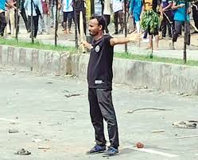
Quota System Before and After 5 August in Bangladesh
Before 5 August 2018:
Structure: The quota system reserved 56% of government jobs for specific groups:
On 21 July 2024, Supreme Court of Bangladesh increased recruitment to government jobs based

Slide 12
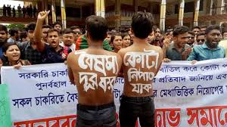
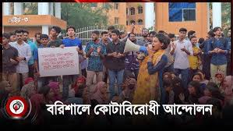
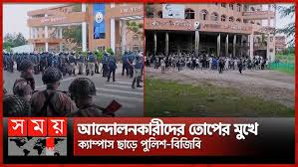
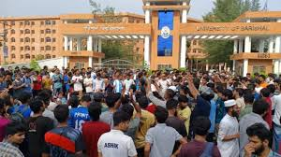
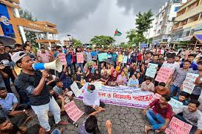
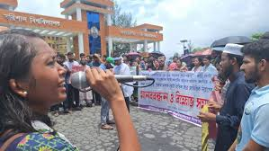
Quota movement in Barishal University

Slide 13
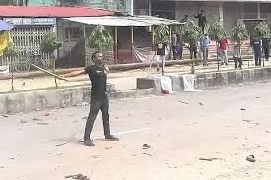
THANK YOU

